Slide 1
Data Analysis with Python Pandas Dataframes
Žydrūnė Kelpšaitė, Data Analyst

Slide 2
DATAFRAMES
Pandas DataFrames, the Python equivalent of an Excel or SQLtable which we’ll use to store and analyze data

Slide 3
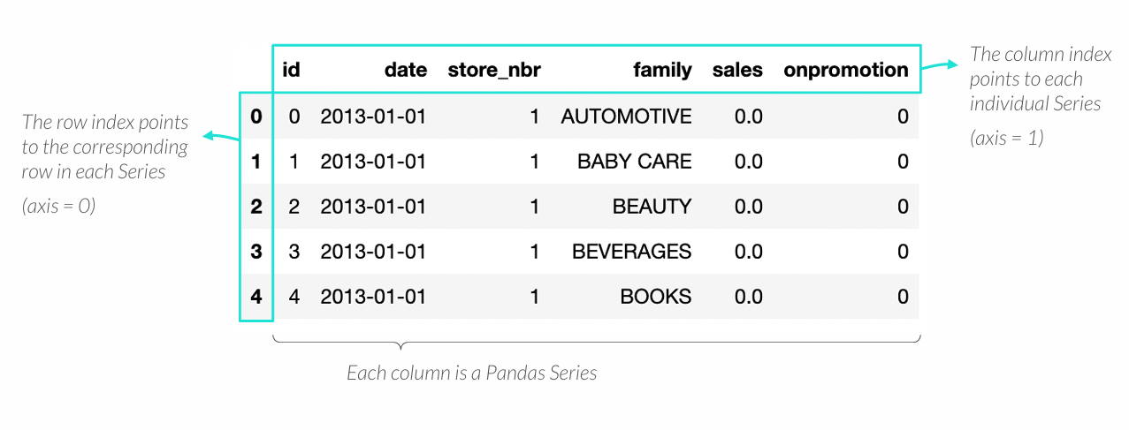
THE PANDAS DATAFRAME
DataFrames are Pandas “tables” made up from columns and rows
• Each column of data in a DataFrame is a Pandas Series that shares the same row index
• The column headers work as a column index that contains the Series names

Slide 4
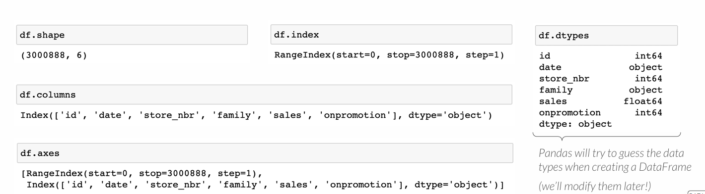
DATAFRAME PROPERTIES
DataFrame shave these key properties:
• shape –the number of rows and columns in a DataFrame (the index is not considered a column)
• index–the row index in a DataFrame, represented as a range of integers (axis=0)
• columns–the column index in a DataFrame, represented by the Series names (axis=1)
• axes–the row and column indices in a DataFrame
• dtypes–the data type for each Series in a DataFrame (they can be different!)

Slide 5
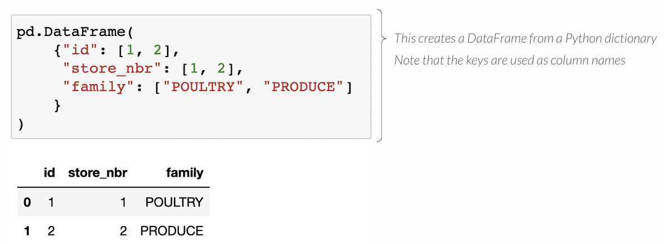
CREATING A DATAFRAME
You can create a DataFrame from a Python dictionary or NumPy array by using the Pandas DataFrame() function

Slide 6
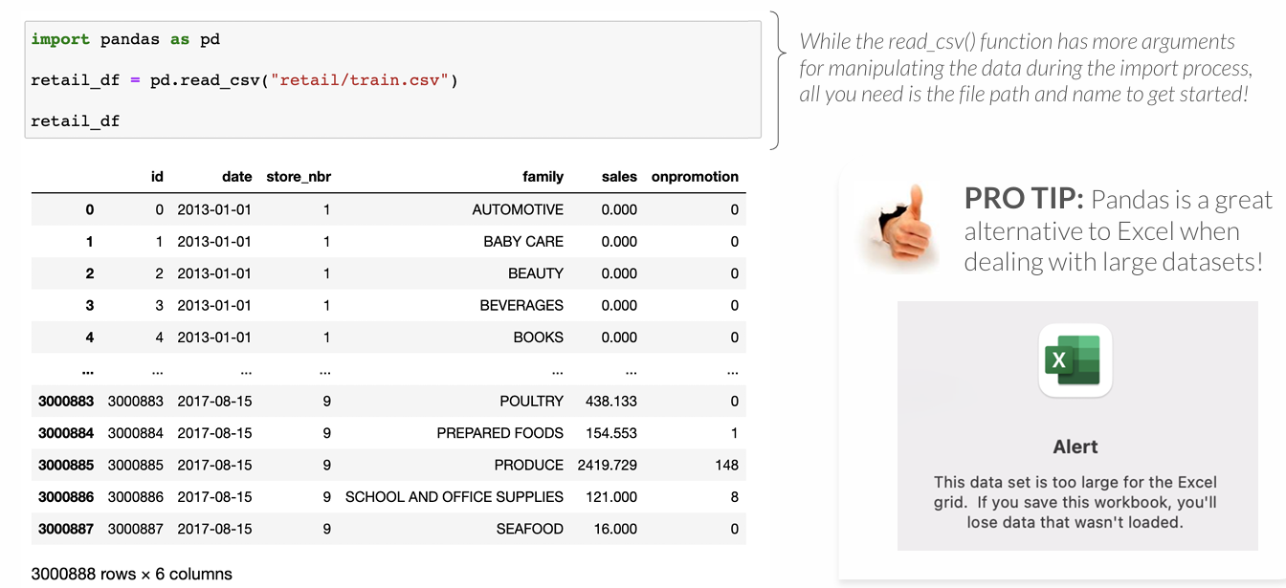
CREATING A DATAFRAME
You’ll more likely create a DataFrame by reading in a flat file (csv, txt, or tsv) with Pandas read_csv() function

Slide 7
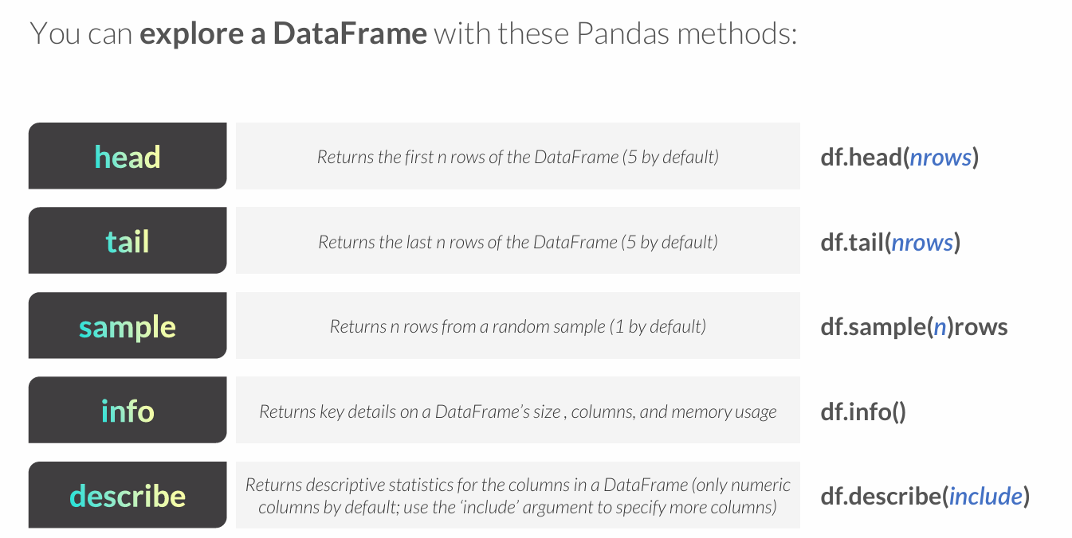
EXPLORING A DATAFRAME

Slide 8
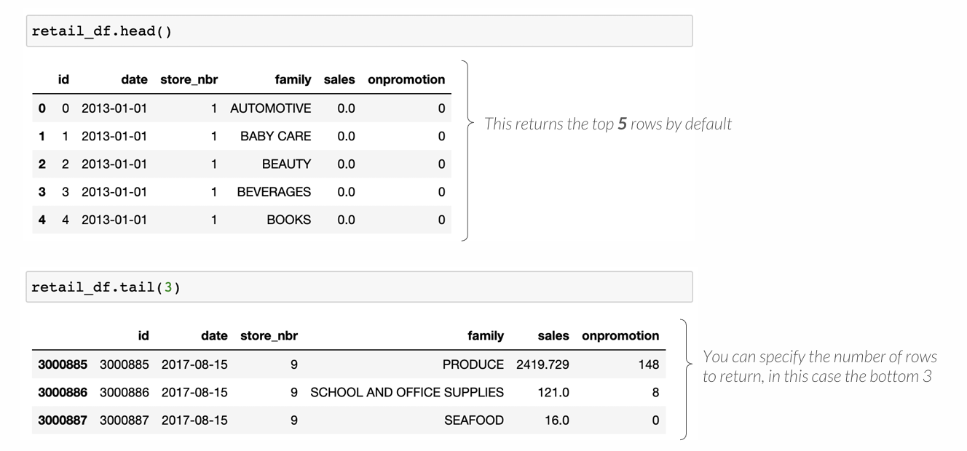
HEAD & TAIL
The .head() and .tail() methods return the top or bottom rows in a DataFrame

Slide 9
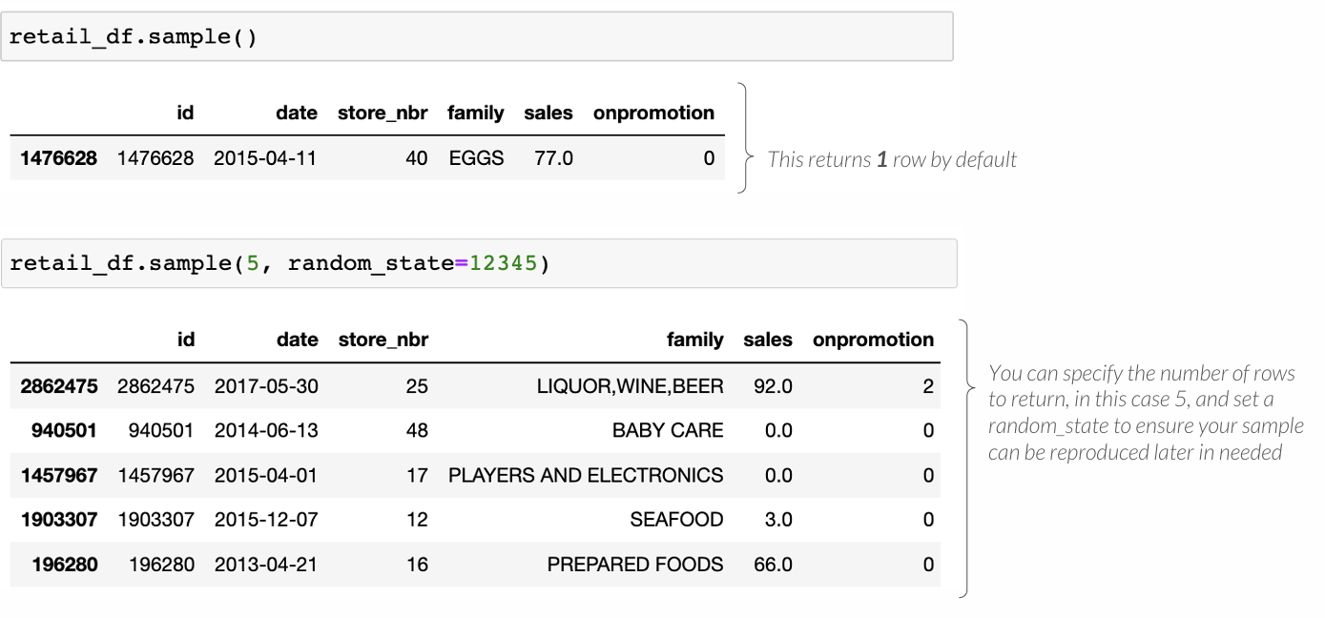
SAMPLE
The .sample() method returns a random sample of rows from a DataFrame

Slide 10
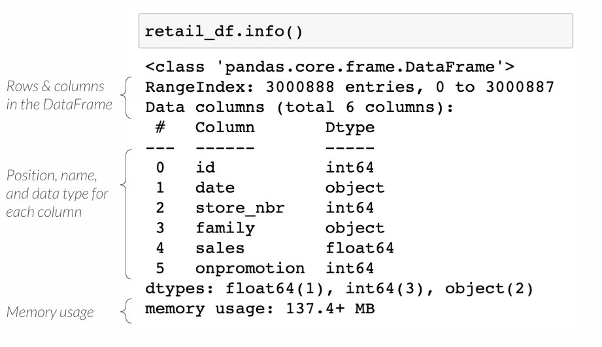
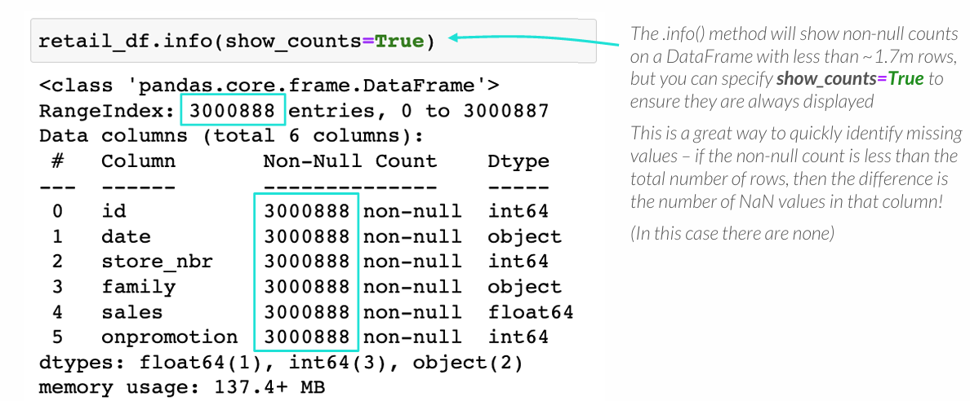
INFO
The .info() method returns details on a DataFrame’s properties and memory usage

Slide 11
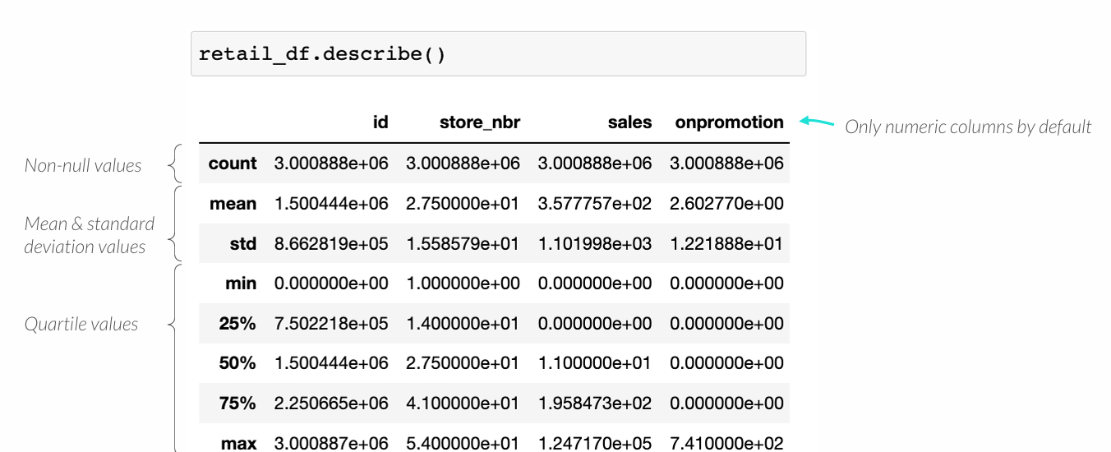
DESCRIBE
The .describe() method returns key statistics on a DataFrame’s columns

Slide 12
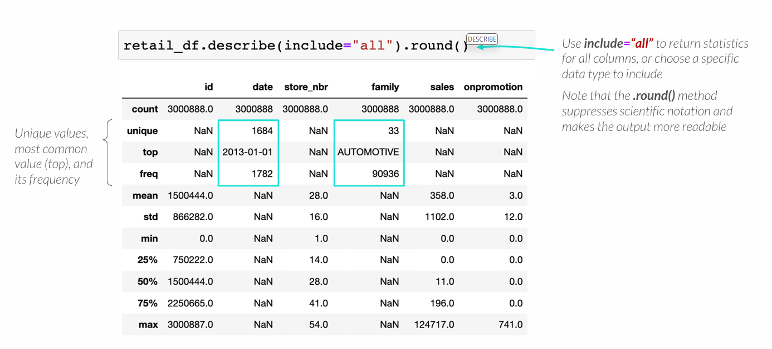
DESCRIBE
The .describe() method returns key statistics on a DataFrame’s columns

Slide 13
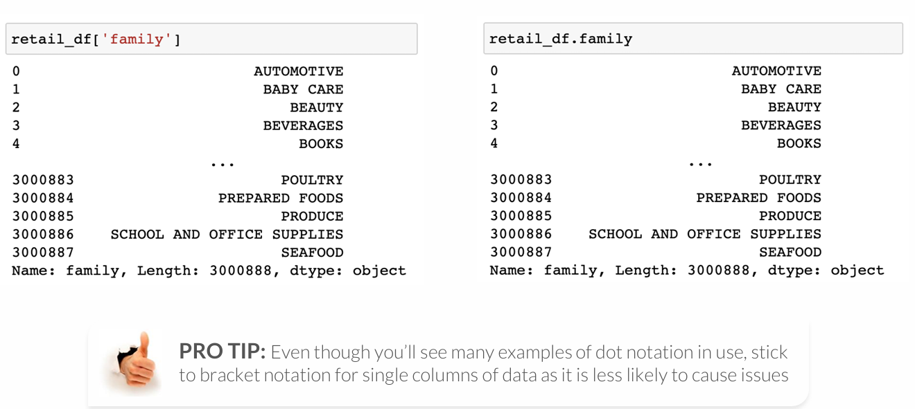
ACCESING DATAFRAME COLUMNS
You can access a DataFrame column by using bracket or dot notation
• Dot notation only works for valid Python variable names (no spaces, special characters, etc.), and if the column name is not the same as an existing variable or method

Slide 14
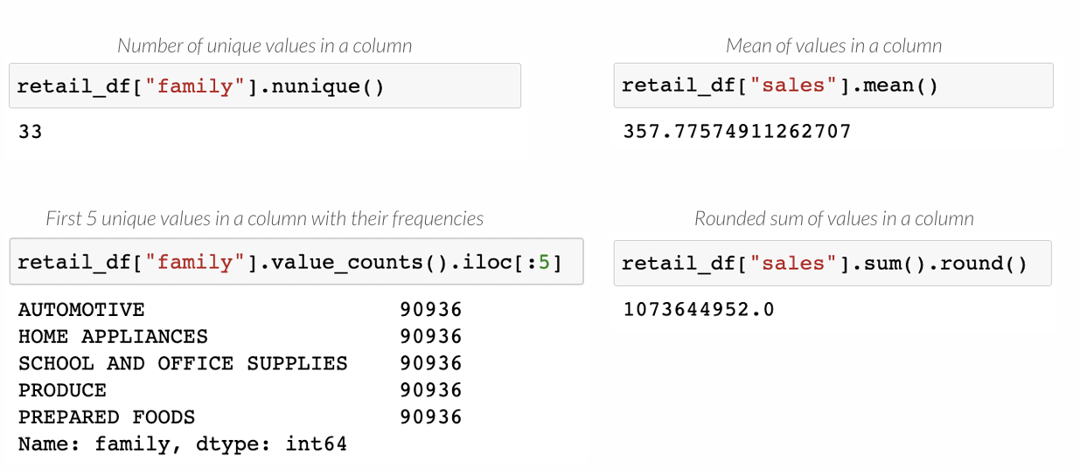
ACCESING DATAFRAME COLUMNS
You can use Series operations on DataFrame columns (each column is a Series!)

Slide 15
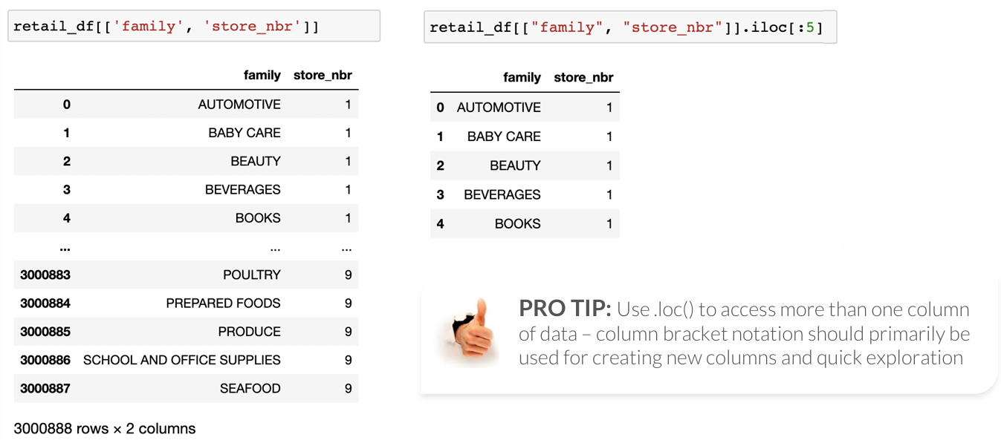
ACCESING DATAFRAME COLUMNS
You can select multiple columns with a list of column names between brackets
• This is ideal for selecting non-consecutive columns in a DataFrame

Slide 16
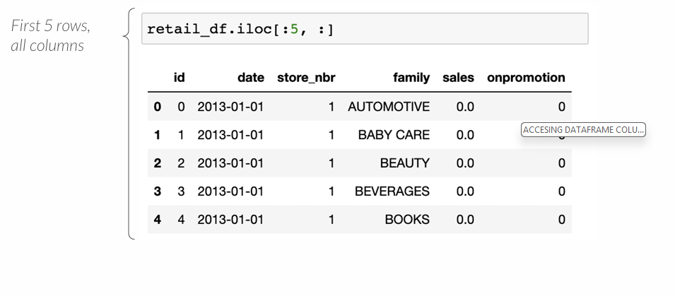
ACCESING DATA WITH ILOC
The .iloc() accessor filters DataFrames by their row and column indices
• The first parameter accesses rows, and the second accesses columns

Slide 17
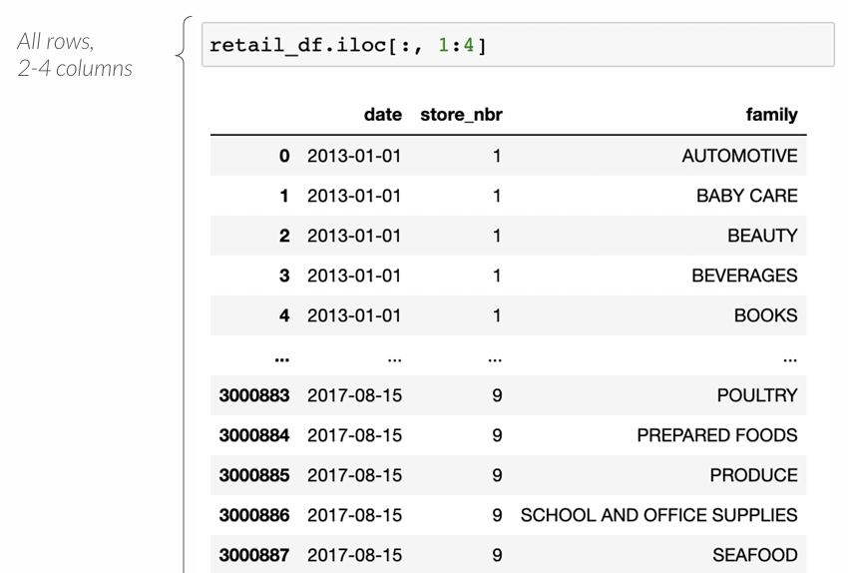
ACCESING DATA WITH ILOC
The .iloc() accessor filters DataFrames by their row and column indices
• The first parameter accesses rows, and the second accesses columns

Slide 18
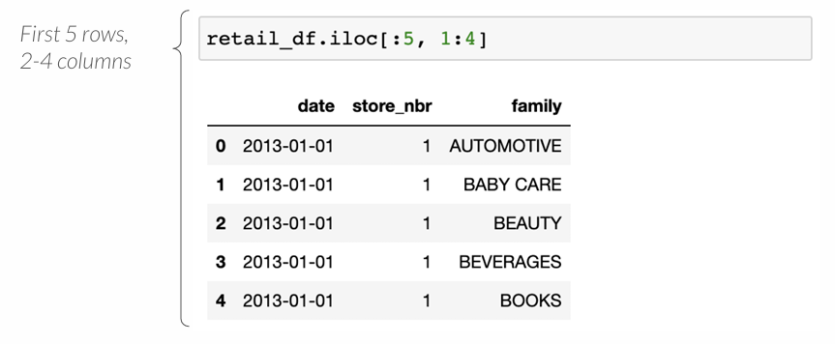
ACCESING DATA WITH ILOC
The .iloc() accessor filters DataFrames by their row and column indices
• The first parameter accesses rows, and the second accesses columns

Slide 19
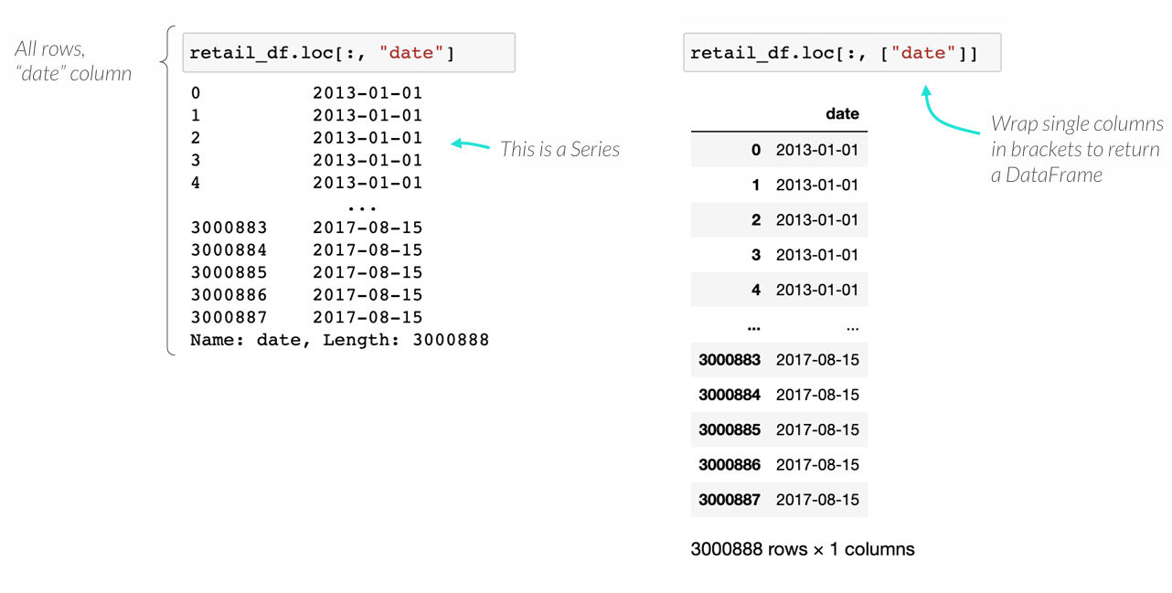
ACCESING DATA WITH LOC
The .loc() accessor filters DataFrames by their row and column labels
• The first parameter accesses rows, and the second accesses columns

Slide 20
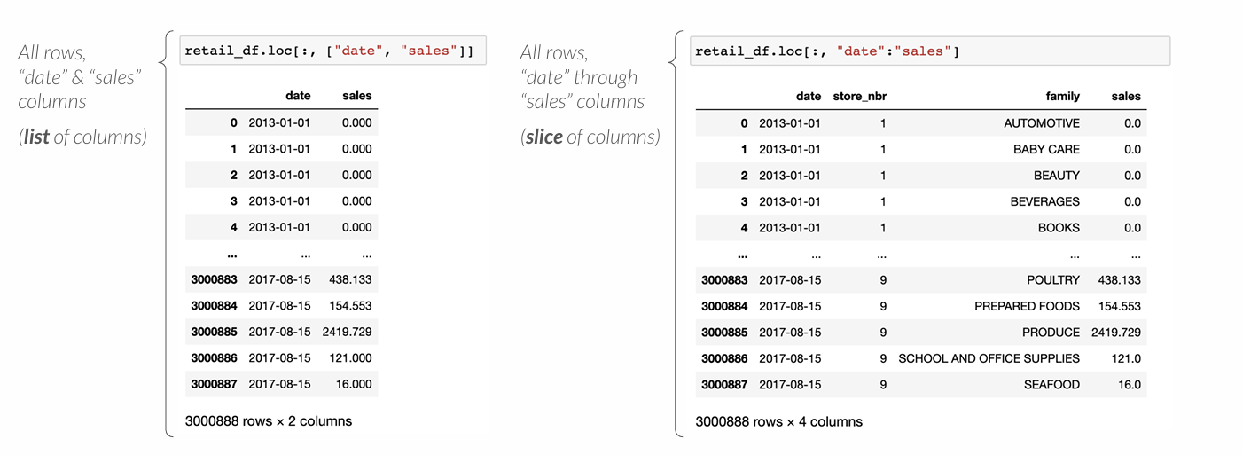
ACCESING DATA WITH LOC
The .loc() accessor filters DataFrames by their row and column labels
• The first parameter accesses rows, and the second accesses columns

Slide 21
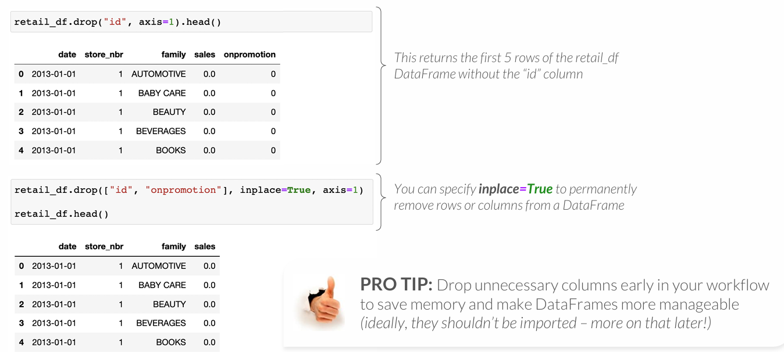
DROPPING ROWS & COLUMNS
The .drop() method drops rows and columns from a DataFrame
• Specify axis=0 to drop rows by label, and axis=1 to drop columns

Slide 22
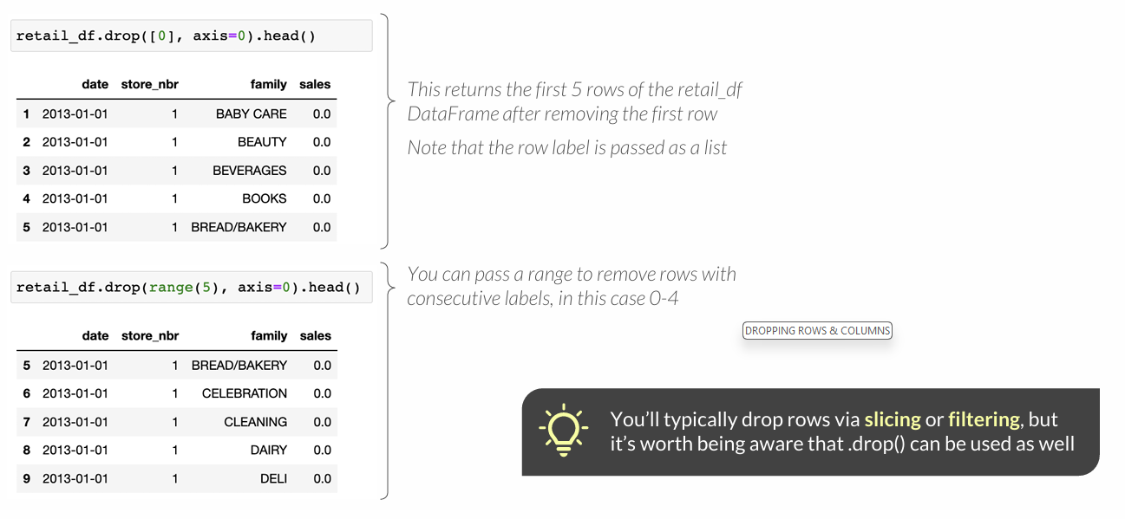
DROPPING ROWS & COLUMNS
The .drop() method drops rows and columns from a DataFrame
• Specify axis=0 to drop rows by label, and axis=1 to drop columns

Slide 23
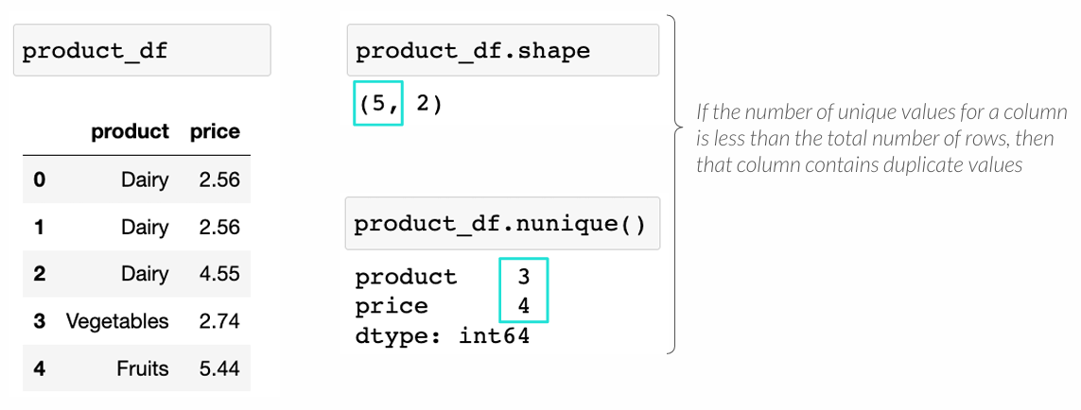
IDENTIFYING DUPLICATE ROWS
The .duplicated() method identifies duplicate rows of data
• Specify subset=column(s) to look for duplicates across a subset of columns

Slide 24
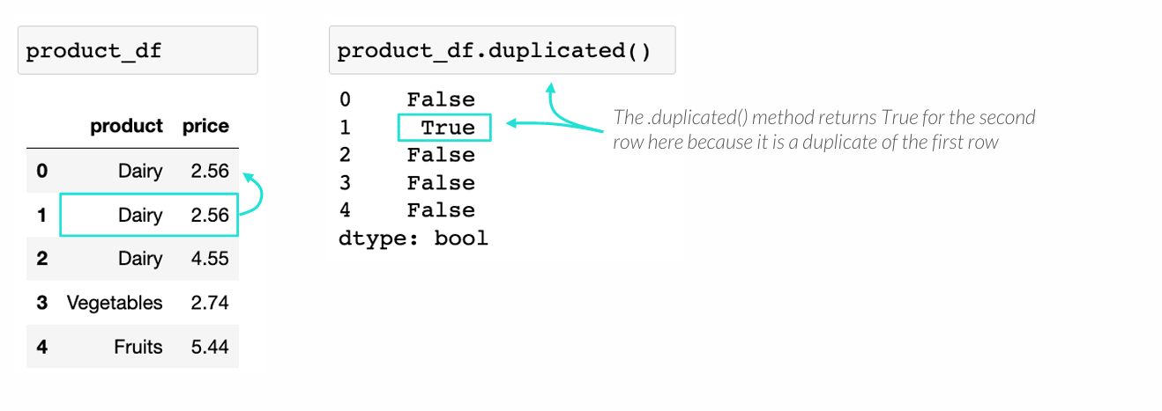
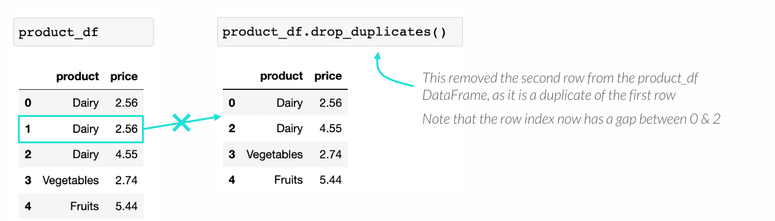
IDENTIFYING DUPLICATE ROWS
The .duplicated() method identifies duplicate rows of data
• Specify subset=column(s) to look for duplicates across a subset of columns

Slide 25
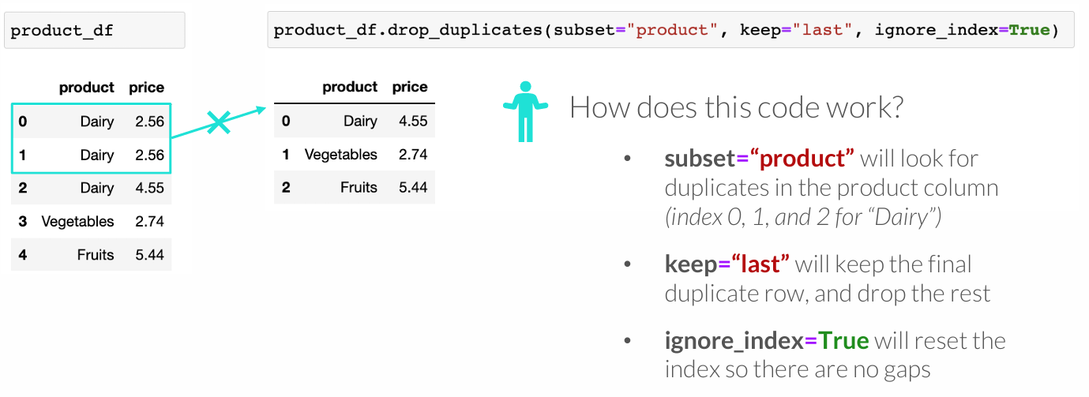
IDENTIFYING DUPLICATE ROWS
The .duplicated() method identifies duplicate rows of data
• Specify subset=column(s) to look for duplicates across a subset of columns

Slide 26
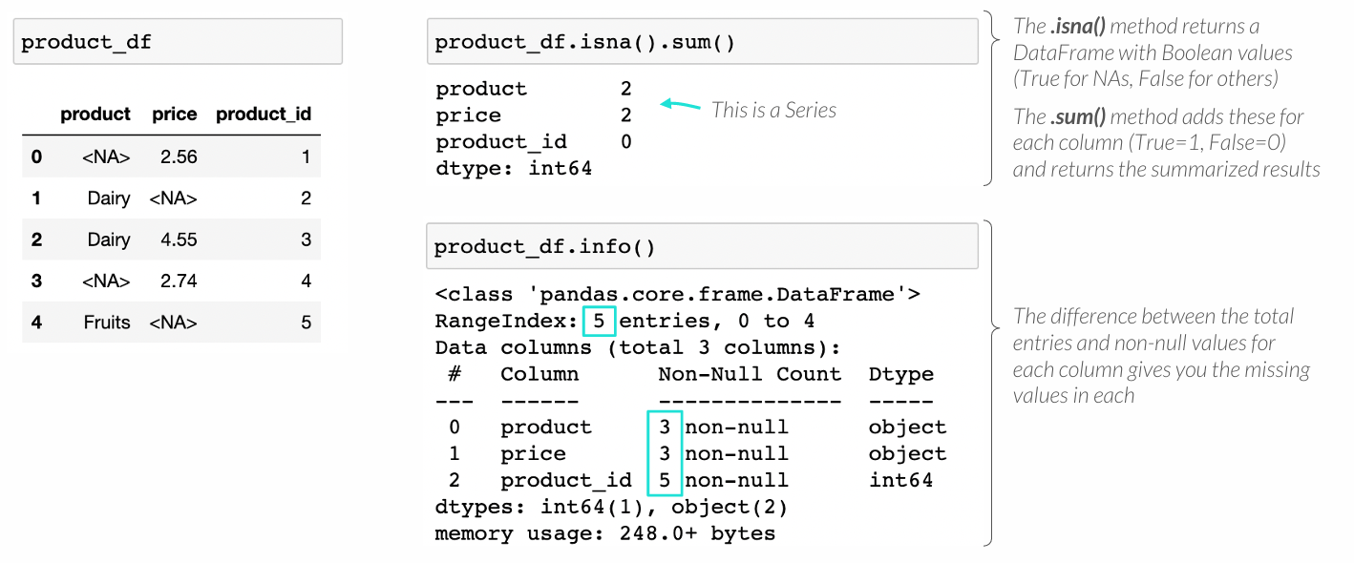
IDENTIFYING MISSING DATA
You can identify missing data by column using the .isna() and .sum() methods
• The .info() method can also help identify null values

Slide 27
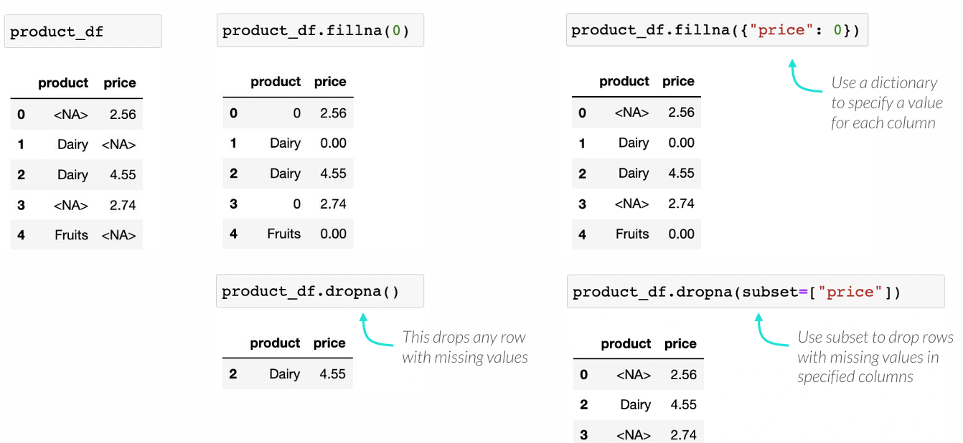
HANDLING MISSING DATA
Like with Series, the .dropna() and .fillna() methods let you handle missing data in a DataFrame by either removing them or replacing them with other values

Slide 28
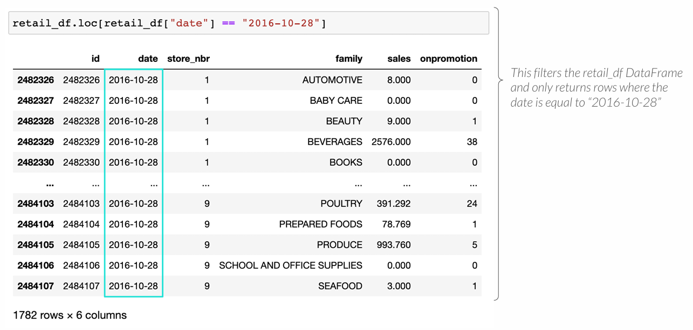
FILTERING DATAFRAMES
You can filter the rows in a DataFrame by passing a logical test into the .loc[] accessor, just like filtering a Series or a NumPy array

Slide 29
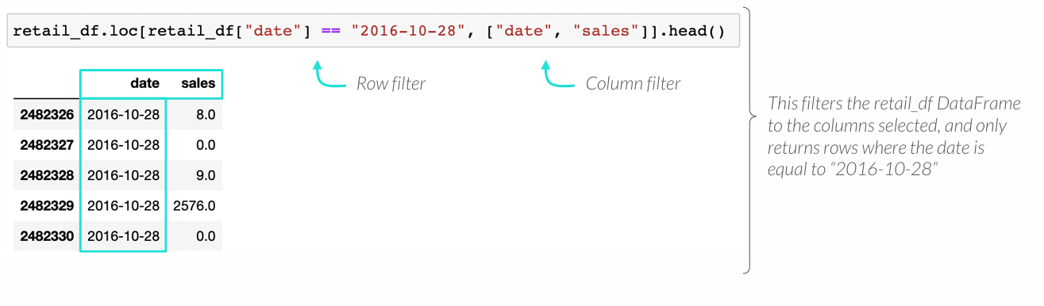
FILTERING DATAFRAMES
You can filter the columns in a DataFrame by passing them into the .loc[] accessor as a list or a slice

Slide 30
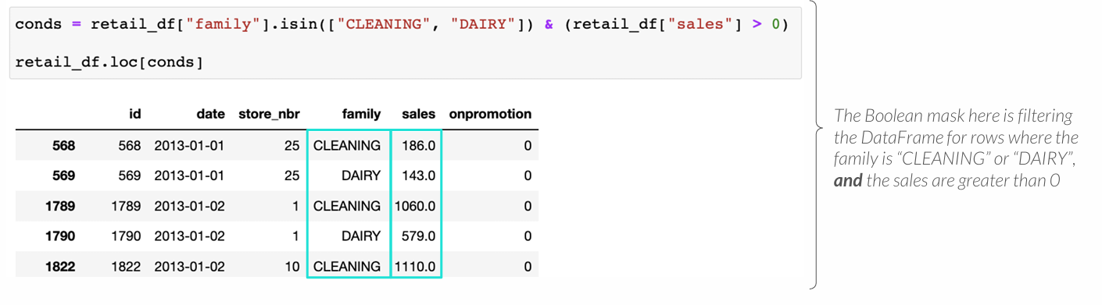
FILTERING DATAFRAMES
You can apply multiple filters by joining the logical tests with an “&” operator
• Try creating a Boolean mask for creating filters with complex logic

Slide 31
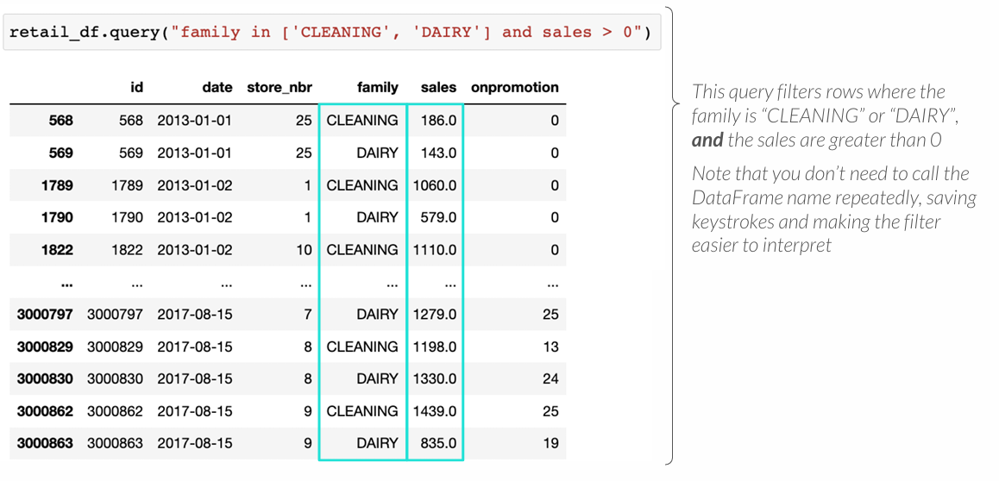
PRO TIP:QUERY
The .query() method lets you use SQL-like syntax to filter DataFrames
• You can specify any number of filtering conditions by using the “and” & “or” keywords

Slide 32
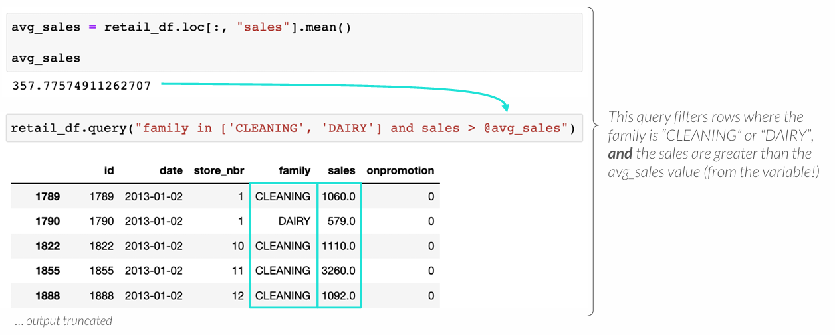
PRO TIP:QUERY
The .query()method lets you use SQL-like syntax to filter DataFrames
• You can specify any number of filtering conditions by using the “and” & “or” keywords
• You can reference variables by using the “@” symbol

Slide 33
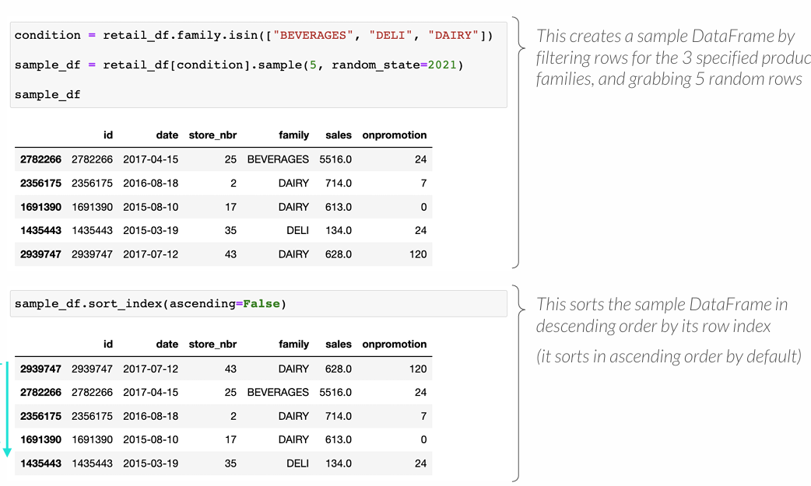
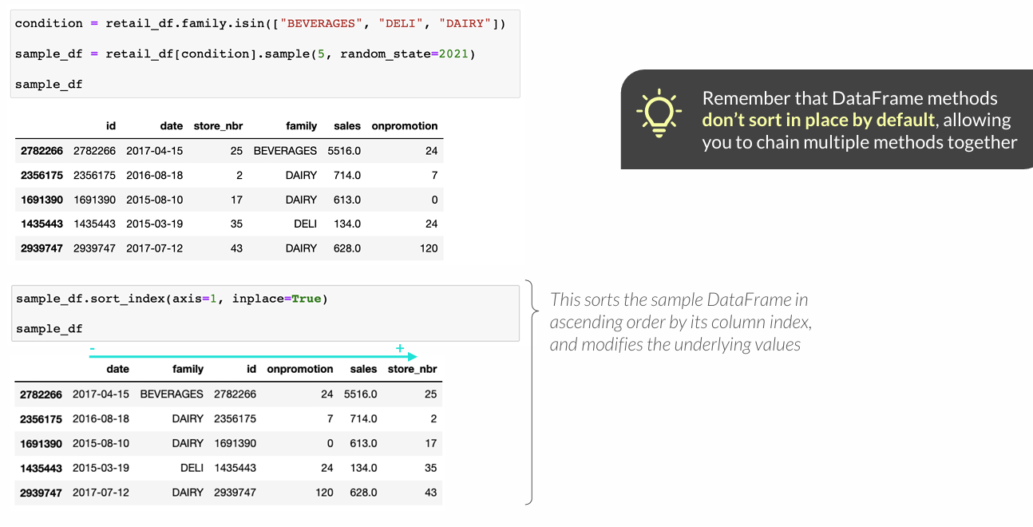
SORTING DATAFRAMES BY INDICES
You can sort a DataFrame by its indices using the .sort_index() method
• This sorts rows (axis=0) by default, but you can specify axis=1 to sort the columns

Slide 34
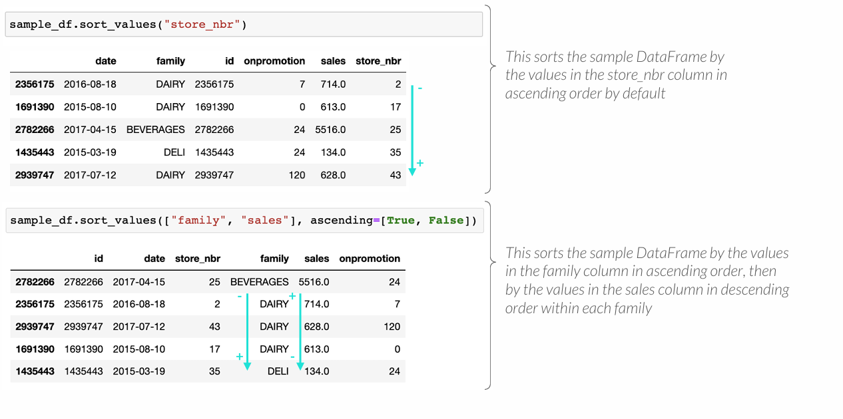
SORTING DATAFRAMES BY VALUES
You can sort a DataFrame by its values using the .sort_values() method
• You can sort by a single column or by multiple columns

Slide 35
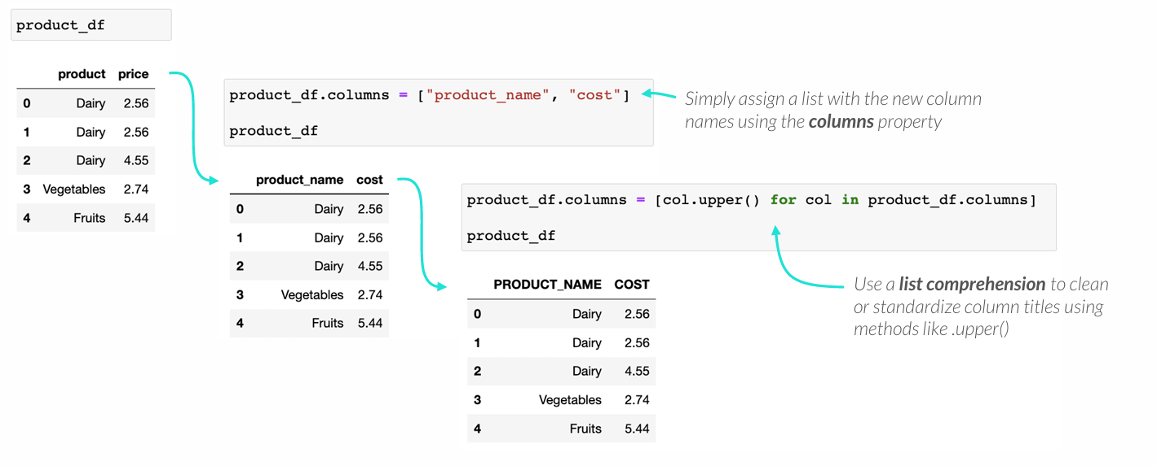
RENAMING COLUMNS
Rename columns in place via assignment using the “columns” property

Slide 36
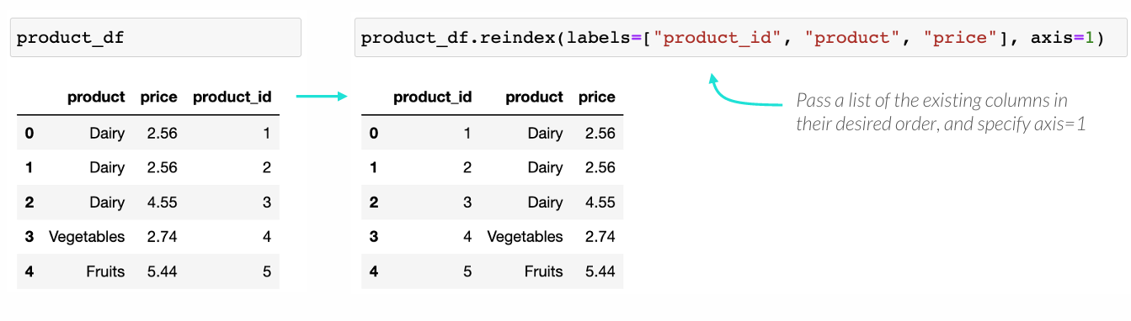
REORDERING COLUMNS
Reorder columns with the .reindex() method when sorting won’t suffice

Slide 37
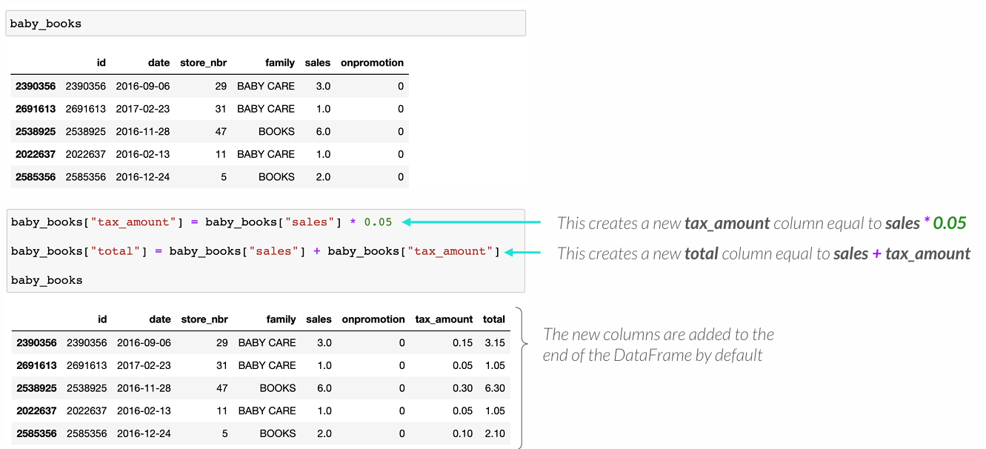
ARITHMETIC COLUMN CREATION
You can create columns with arithmetic by assigning them Series operations
• Simply specify the new column name and assign the operation of interest
Notes:
SVARBU

Slide 38
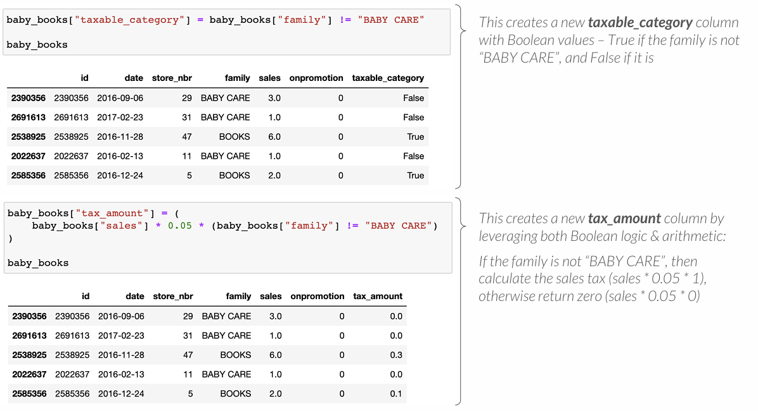
BOOLEAN COLUMN CREATION
You can create Boolean columns by assigning them a logical test
Notes:
SVARBU

Slide 39
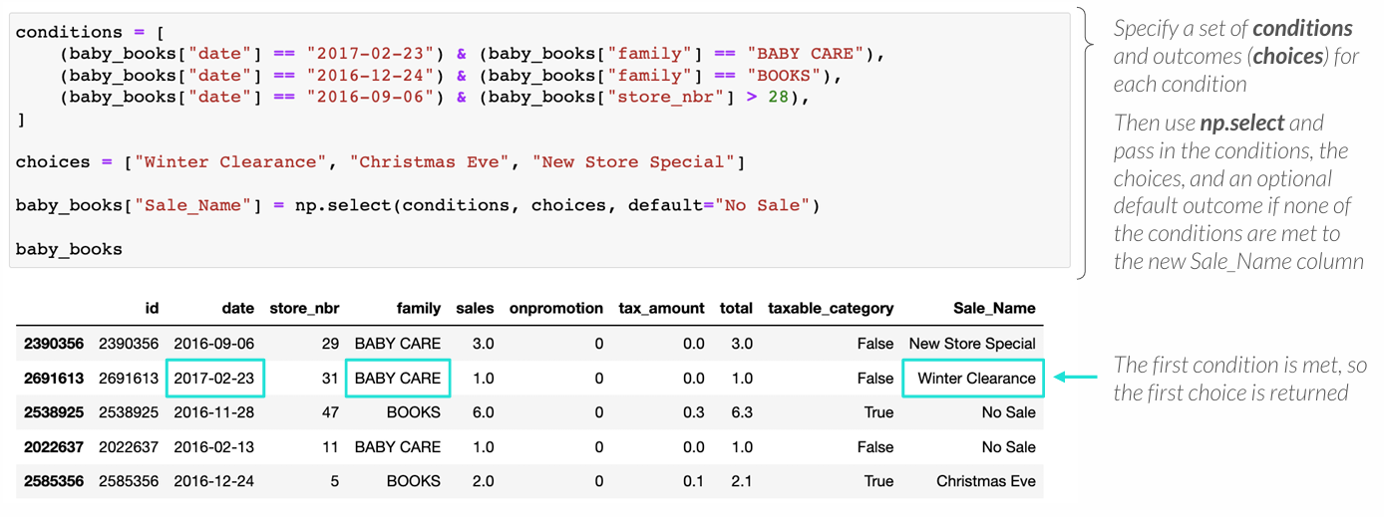
PRO TIP: NUMPY SELECT
NumPy’s select() function lets you create columns based on multiple conditions
• This is more flexible than NumPy’s where() function or Pandas’ .where() method
Notes:
L Svarbu

Slide 40
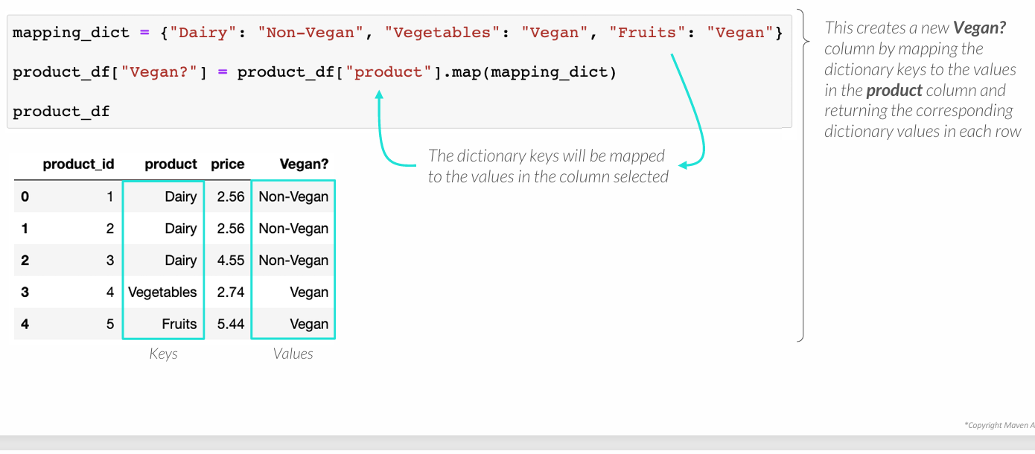
MAPPING VALUES TO COLUMNS
The .map() method maps values to a column or an entire DataFrame
• You can pass a dictionary with existing values as the keys, and new values as the values

Slide 41
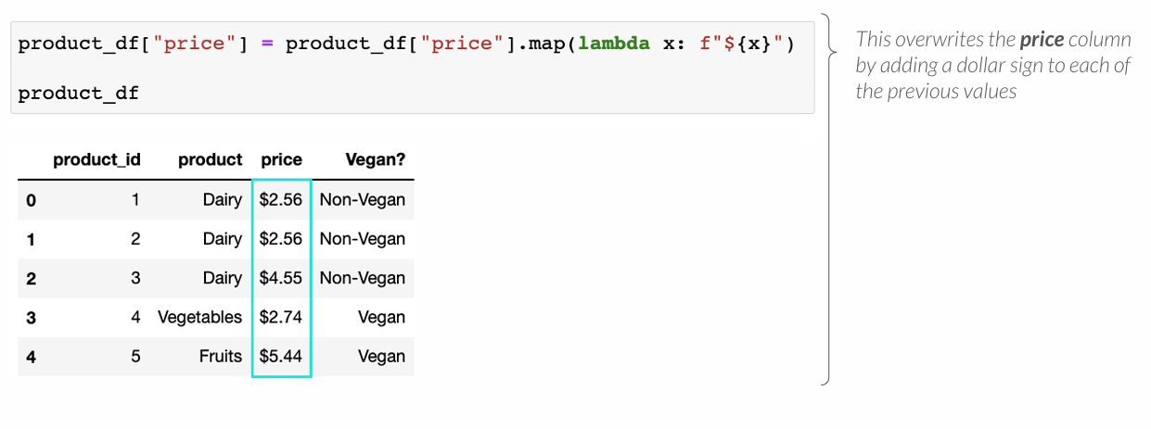
MAPPING VALUES TO COLUMNS
The .map() method maps values to a column or an entire DataFrame
• You can pass a dictionary with existing values as the keys, and new values as the values
• You can apply lambda functions (and others!)

Slide 42
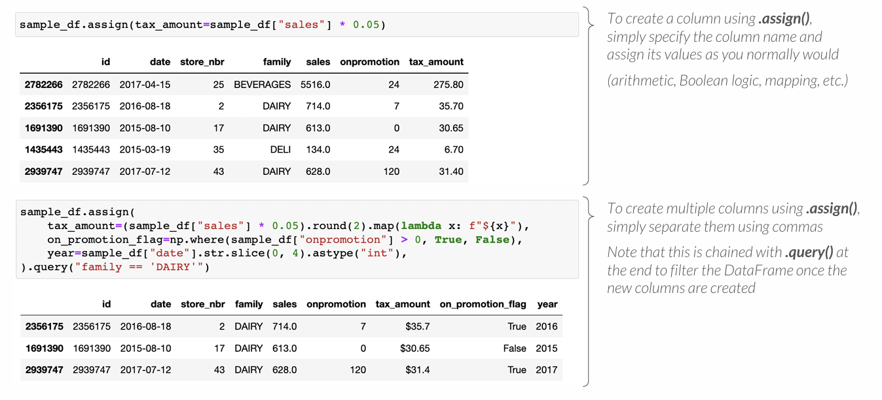
PRO TIP: COLUMN CREATION WITH ASSIGN
The .assign() method creates multiple columns at once and returns a DataFrame
• This can be chained together with other data processing methods
Notes:
L Svarbu

Slide 43
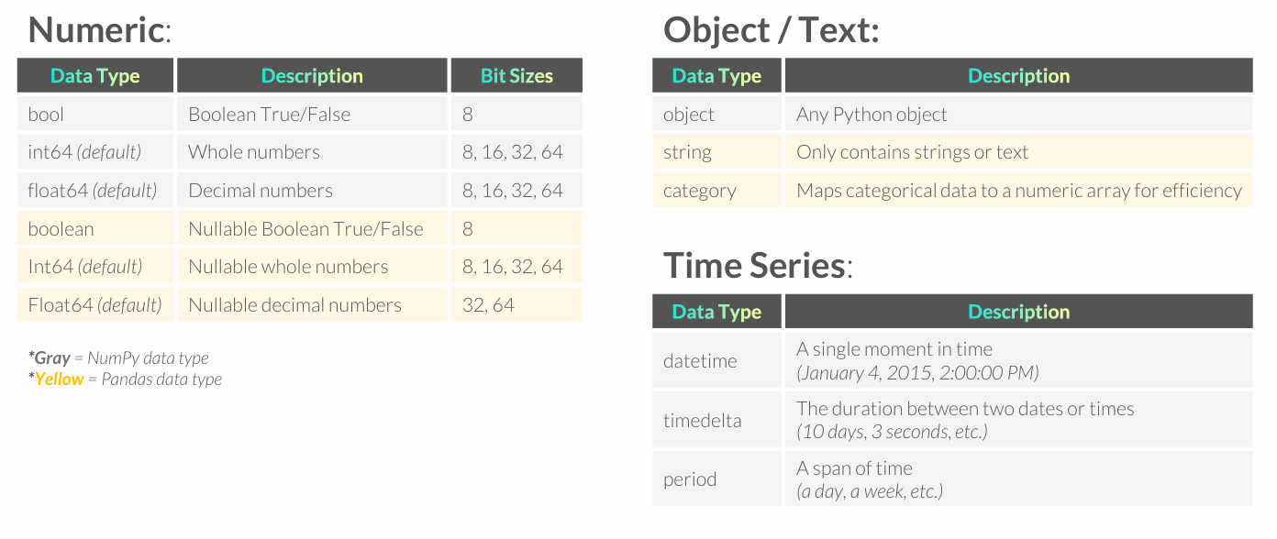
REVIEW: PANDAS DATA TYPES
Pandas data types mostly expand on their base Python and NumPy equivalents

Slide 44
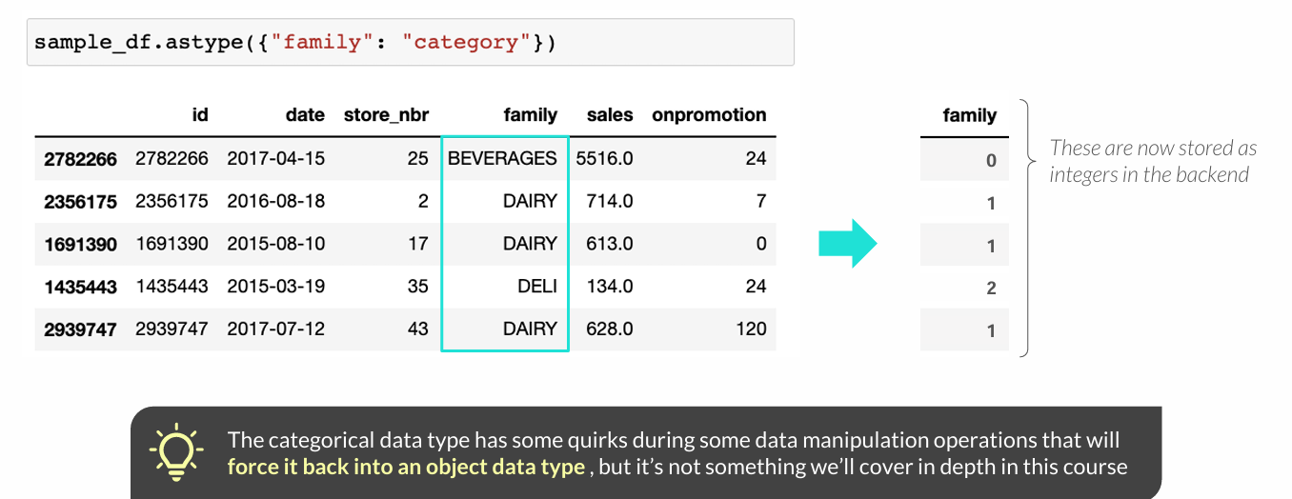
THE CATEGORICAL DATA TYPE
The Pandas categorical data type stores text data with repeated values efficiently
• Python maps each unique category to an integer to save space
• As a rule of thumb, only consider this data type when
unique categories < number of rows / 2

Slide 45
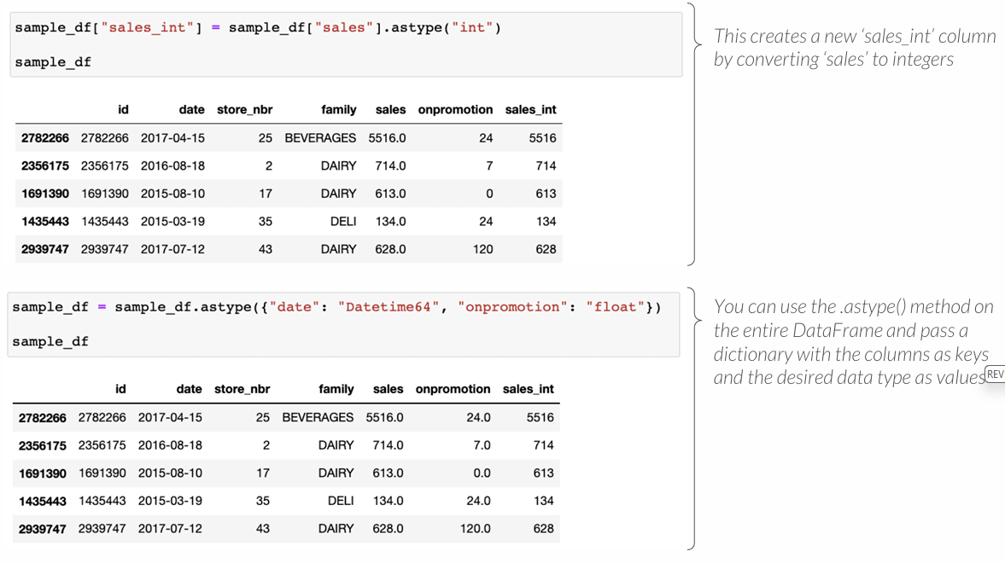
TYPE CONVERSION
Like Series, you can convert data types in a DataFrame by using the .astype() method and specifying the desired data type (if compatible)
Notes:
SVARBU

Slide 46
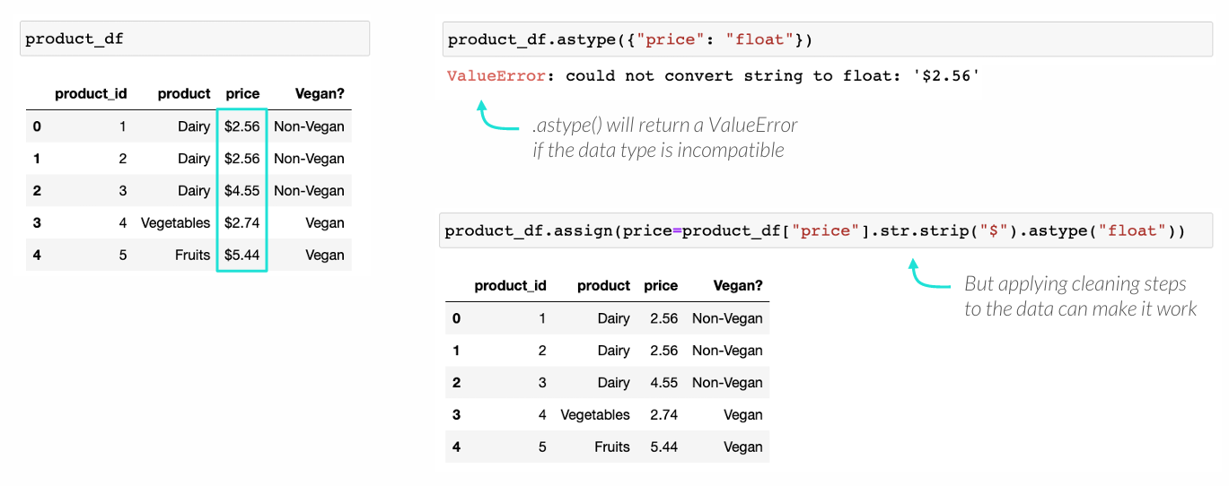
TYPE CONVERSION
Like Series, you can convert data types in a DataFrame by using the .astype() method and specifying the desired data type (if compatible)

